Slide 1

ICE 3161
COMMUNICATION ENGINEERING
Dr. Asif Zaman
Professor, CSE, RU

Slide 2
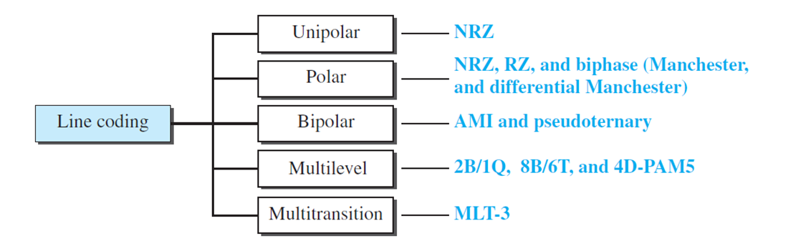
Digital-to-digital Conversion
The conversion involves three techniques:
line coding,
block coding, and
scrambling.

Slide 3
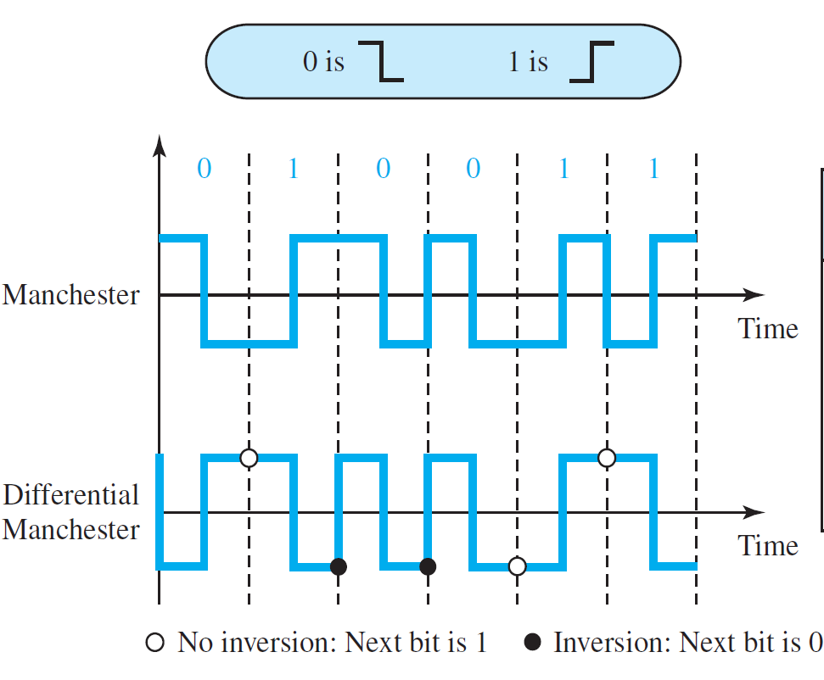
Biphase: Manchester and Differential Manchester
The idea of RZ (transition at the middle of the bit) and the idea of NRZ-L are combined into the Manchester scheme.
In Manchester encoding, the duration of the bit is divided into two levels.
The voltage remains at one level during the first half and moves to the other level in the second half.
The transition at the middle of the bit provides synchronization

Slide 4
Biphase: Manchester and Differential Manchester
Differential Manchester, on the other hand, combines the ideas of RZ and NRZ-I. There is always a transition at the middle of the bit, but the bit values are determined at the beginning of the bit.
There is always a transition at the middle of the bit, but the bit values are determined at the beginning of the bit.
If the next bit is 0, there is a transition;
if the next bit is 1, there is none.

Slide 5
Bipolar Schemes
In bipolar encoding (sometimes called multilevel binary), there are three voltage levels:
positive,
negative, and
zero.
The voltage level for one data element is at zero, while the voltage level for the other element alternates between positive and negative.
Two Scheme:
AMI and
Pseudoternary

Slide 6
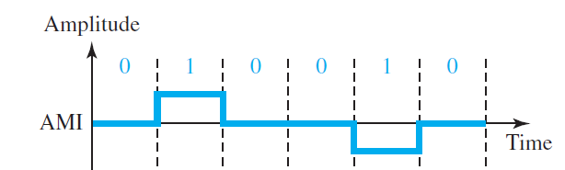
Bipolar Schemes: AMI
Alternate Mark Inversion (AMI).
A neutral zero voltage represents binary 0
Binary 1s are represented by alternating positive and negative voltages

Slide 7
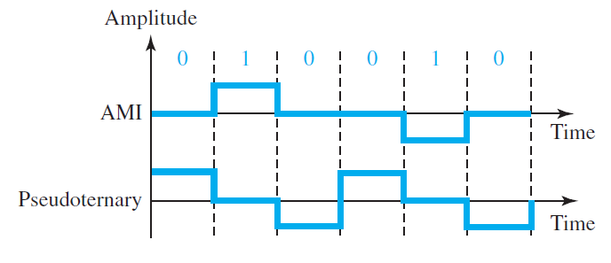
Bipolar Schemes: Pseudoternary
A variation of AMI encoding is called pseudoternary in which
The 1 bit is encoded as a zero voltage and
the 0 bit is encoded as alternating positive and negative voltages

Slide 8
Multilevel Schemes
mBnL
where m is the length of the binary pattern,
B means binary data,
n is the length of the signal pattern, and
L is the number of levels in the signaling.
A letter is often used in place of L:
B(binary) for L = 2,
T (ternary) for L = 3, and
Q (quaternary) for L = 4.
2B1Q
8B6T

Slide 9
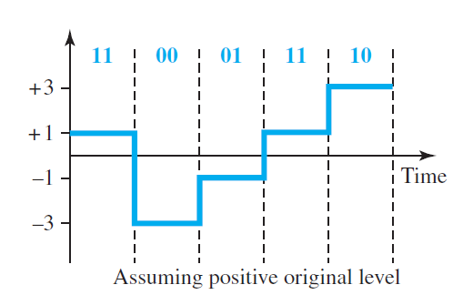

Multilevel: 2B1Q scheme

Slide 10
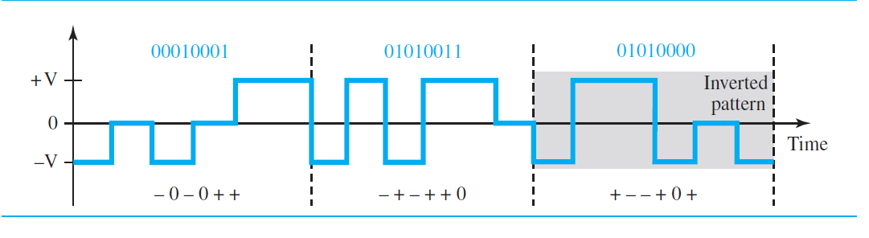
Multilevel: 8B6T scheme
01010000 should be encoded as + − − + 0 + with weight +1
− 0 − 0 + + with weight 0
− + − + + 0 with weight +1
In this type of scheme, we can have
2^8 = 256 different data patterns and
3^6 = 729 different signal patterns.
There are 729 − 256 = 473 redundant signal elements that provide synchronization and error detection.

Slide 11
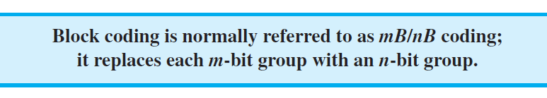
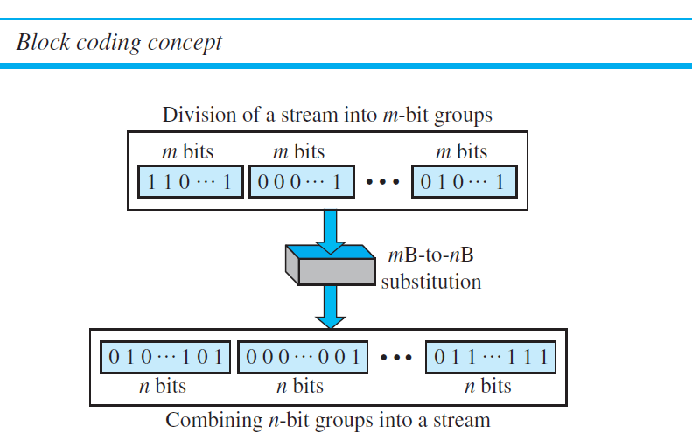
Block Coding
Block coding changes a block of m bits into a block of n bits, where n is larger than m.
Block coding is referred to as an mB/nB encoding technique.

Slide 12
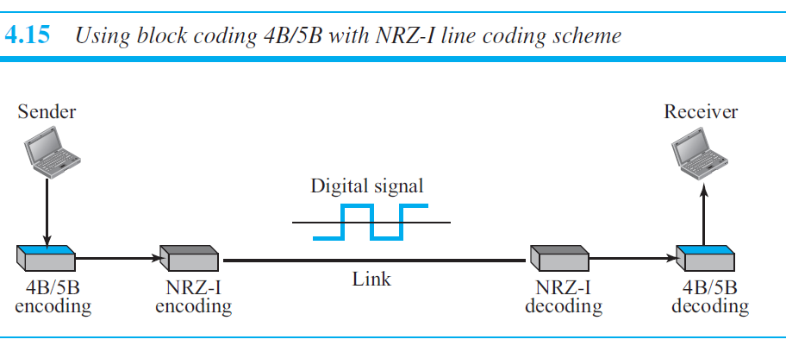

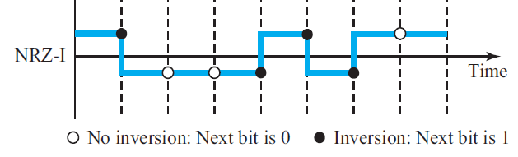
Four binary/five binary (4B/5B)

Slide 13
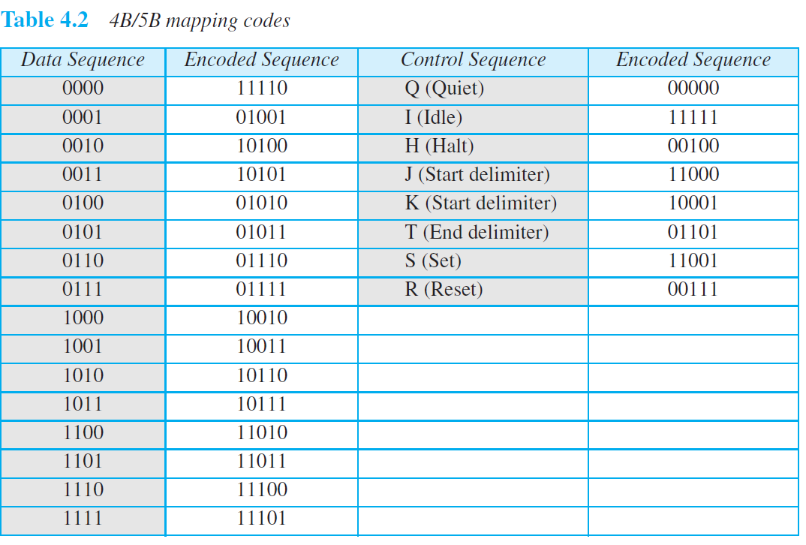
Four binary/five binary (4B/5B)
In 4B/5B, …no more than one leading zero (left bit) and no more than two trailing zeros (right bits).

Slide 14
Scrambling
We are looking for a technique that does not increase the number of bits and does provide synchronization.
We are looking for a solution that substitutes long zero-level pulses with a combination of other levels to provide synchronization.
One solution is called scrambling.
Two common scrambling techniques are B8ZS and HDB3.

Slide 15
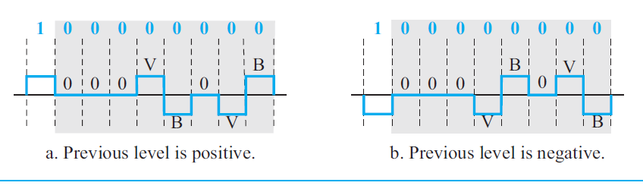

Scrambling: B8ZS
Bipolar with 8-zero substitution (B8ZS)
The V in the sequence denotes violation; this is a nonzero voltage that breaks an AMI rule of encoding (opposite polarity from the previous).
The B in the sequence denotes bipolar, which means a nonzero level voltage in accordance with the AMI rule.

Slide 16
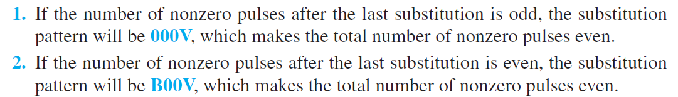
Scrambling: HDB3
High-density bipolar 3-zero (HDB3) is commonly used outside of North America.
Four consecutive zero-level voltages are replaced with a sequence of 000V or B00V.
The reason for two different substitutions is to maintain the even number of nonzero pulses after each substitution

Slide 17
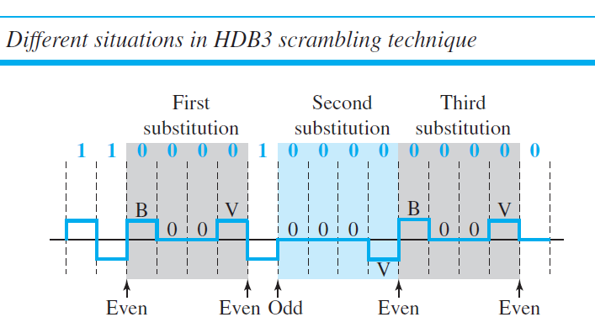
Scrambling: HDB3
Non-Zero Pulse: EVEN

